Slide 1
NCRMP Hawaiian Islands Report Card: Benthic Indicators

Slide 2
Benthic indicators: MHI 2016
OVERALL GOAL: Include a limited number of metrics that provide stable indicators of coral population status.
Workshop Goals to Identify:
Coral species to include
Spatial scale (island, strata or island)
Scoring method to use & what unit

Slide 3
Benthic indicators: Coral populations
Provides information about existing coral populations and incorporates a mechanism to determine about how coral populations are changing over time.

Slide 4
Benthic Indicators: MHI
Coral Population Indicators
Juvenile density
Adult density
Partial mortality – old dead
Lists represent abundant and important taxa across all islands

Slide 5
% of Max Method for Scoring Indicators
Used 2013 max as reference = pre-bleaching
For each site, strata and island & taxon calculated % of 2013 max value.
For partial mortality we also calculated % of 40% max mortality (very severe).
Colony Density
Mortality

Slide 6
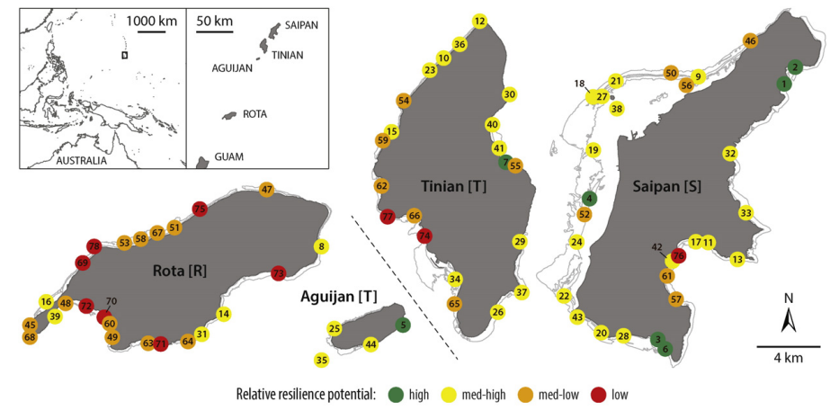
Mean/SD Method for Scoring Indicators
Using 2013 Regional (MHI) weighted average of metric as reference. (2013 = pre-bleaching)
Generate scores for each taxon
average across all taxa = island score
Maynard et al. 2015

Slide 7
Benthic indicator : Juvenile density
Description: mean density of juvenile coral colonies per m² (< 5 cm) for each site or strata, and weighted estimated density at island-level.
Rationale: Provides additional information about the potential outlook for these coral populations – “Are there babies on the reef that will potentially grow to adults?”

Slide 8
Juvenile density: % of Max Method

Slide 9
Juvenile density: % of Max Method
Excellent
Very Good
Good
Fair
Poor

Slide 10
Juvenile density: Mean/SD Method

Slide 11
Juvenile density: Mean/SD Method

Slide 12
Juvenile density: Mean/SD Method
Excellent
Very Good
Good
Fair
Poor

Slide 13
Juvenile density: Method Comparison
% OF MAX METHOD
MEAN/SD METHOD

Slide 14
Benthic indicator : Adult density
Description: mean density of adult coral colonies per m² (≥ 5 cm) for each site or strata, and weighted estimated density at island-level.
Rationale: Provides an abundance metric of reproductive colonies in the selected taxa group.

Slide 15
Adult density: % of Max Method

Slide 16
Adult density: % of Max Method
Excellent
Very Good
Good
Fair
Poor

Slide 17
Adult density: Mean/SD Method

Slide 18
Adult density: Mean/SD Method
Excellent
Very Good
Good
Fair
Poor

Slide 19
Adult density: Method Comparison
% OF MAX METHOD
MEAN/SD METHOD

Slide 20
Benthic indicator : Partial mortality
Description: mean proportion of old dead partial mortality for adult coral colonies (selected taxa) – Weighted estimate for island level.
Rationale: Provides a metric of cumulative partial mortality in the selected taxa group and may be a proxy for loss of reproductive biomass.

Slide 21
Partial Mortality: % of Max Method

Slide 22
Partial Mortality: % of Max Method
Poor
Fair
Good
Very Good
Excellent
Poor
Fair
Good
Very Good
Excellent

Slide 23
Partial Mortality: Mean/SD Method

Slide 24
Partial Mortality: Mean/SD Method
Excellent
Very Good
Good
Fair
Poor

Slide 25
Mortality: Method Comparison
% OF MAX METHOD
MEAN/SD METHOD

Slide 26
Revisiting Workshop Goals:
Coral species to include?
Spatial scale?
Scoring method to use & what unit?

Slide 27
NWHI coral population metrics
Challenges
Coral taxa: archipelago list may not suitable
Scaling metrics: modifications?
Scoring method: modifications?
Action items:
Choose island taxa
Develop appropriate scaling and scoring methods of metrics

Slide 28
Extra Slides

Slide 29
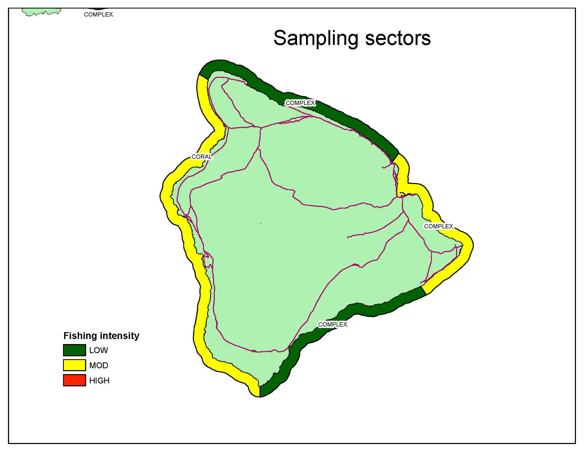

Slide 30
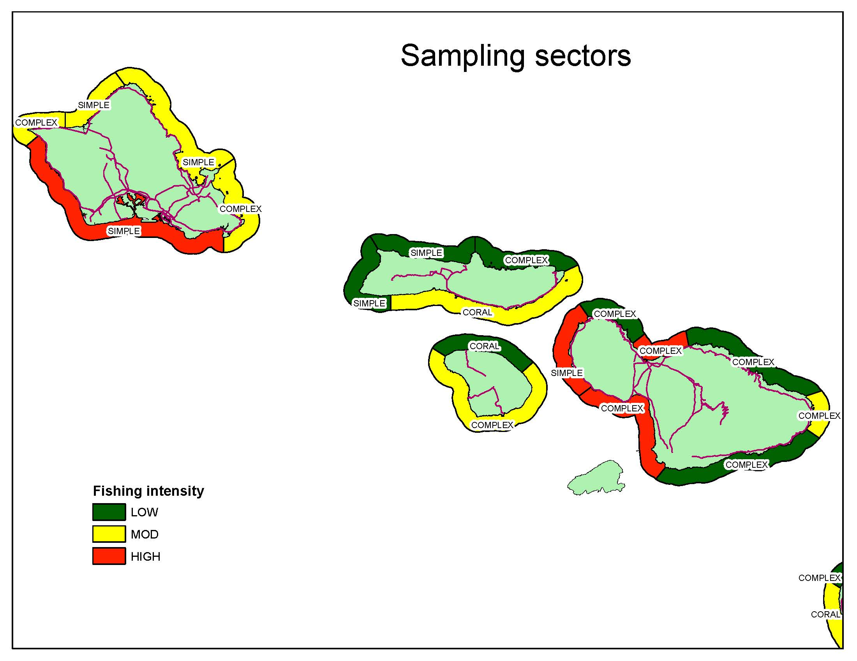

Slide 31
